Slide 1



Effects of ATLS® Training on Adult Trauma Patient Outcomes
Protocol for a Cluster Randomised Trial
Martin Gerdin Wärnberg, PI, Karolinska Institutet

Slide 2
Trauma Scope of the problem
#1
cause of disease burden in people aged 10-49 years
4.3
million deaths globally
$4.2
trillions in the US alone

Slide 3
ATLS® Purpose and content
“emphasizes the rapid initial assessment and primary treatment of injured patients, starting at the time of injury and continuing through initial assessment, lifesaving intervention, reevaluation, stabilization, and, when needed, transfer to a trauma center”
> ATLS® Student Course Manual. 10th ed. 2018.

Slide 4
ATLS® Purpose and content
“… precourse and postcourse tests, core content, interactive discussions, scenario-driven skill stations, lectures, interactive case presentations, discussions, development of lifesaving skills, practical laboratory experiences, and a final performance proficiency evaluation”
> ATLS® Student Course Manual. 10th ed. 2018.

Slide 5
ATLS® Chapters
1
Initial Assessment and Management
2
Airway and Ventilatory Management
3
Shock
4
Thoracic Trauma
5
Abdominal and Pelvic Trauma
6
Head Trauma

Slide 6
ATLS® Chapters
7
Spine and Spinal Cord Trauma
8
Musculoskeletal Trauma
9
Thermal Trauma
10
Pediatric
Trauma
11
Geriatric
Trauma
12
Trauma in Pregnancy and Intimate Partner Violence
13
Transfer to Definitive
Care

Slide 7
ATLS® Spread and dissemination
>1
million physicians trained
>80
countries worldwide
1978
first course

Slide 8
ATLS® Impact on providers’ knowledge and skills
“There is abundant evidence that ATLS training improves the knowledge base, the psychomotor skills and their use in resuscitation, and the confidence and performance of doctors who have taken part in the program. The organization and procedural skills taught in the course are retained by course participants for at least 6 years, which may be the most significant impact of all”
> ATLS® Student Course Manual. 10th ed. 2018.

Slide 9
ATLS® Evidence of impact on providers’ knowledge and skills
Three randomised controlled studies:
Ali J et al. 1995: “Using highly reliable trauma OSCE stations we have demonstrated trauma management skills acquisition by senior medical students after the ATLS course.”
Ali J et al. 1996: “… improvement in OSCE scores, adherence to trauma priorities, maintenance of an organized approach to trauma care, and cognitive performance in MCQ examinations.”
Ali J et al. 1999: “Using standard ATLS pass criteria, performance after the new and old ATLS courses was similar.”

Slide 10
ATLS® Impact on patient outcomes
“ATLS training in a developing country has resulted in a decrease in injury mortality. Lower per capita rates of deaths from injuries are observed in areas where providers have ATLS training. In one study, a small trauma team led by a doctor with ATLS experience had equivalent patient survival when compared with a larger team with more doctors in an urban setting. In addition, there were more unexpected survivors than fatalities”
> ATLS® Student Course Manual. 10th ed. 2018.

Slide 11
ATLS® Evidence of impact on patient outcomes
Four systematic reviews:
Mohammad A et al. 2013: “Future studies are required to properly evaluate the impact of ATLS training on trauma death rates and disability.”
Jayaraman S et al. 2014: “There is no evidence from controlled trials that ATLS or similar programs impact the outcome for victims of injury.”
Jin J et al. 2021: “In-hospital trauma training with certified courses resulted in a reduction of mortality (RR 0.71, 95% CI 0.62 to 0.78).”
Putra AB et al. 2023: “ATLS had no significant effect in reducing the risk of mortality (OR: 0.68; 95% CI 0.39 – 1.20; p = 0.18).”

Slide 12
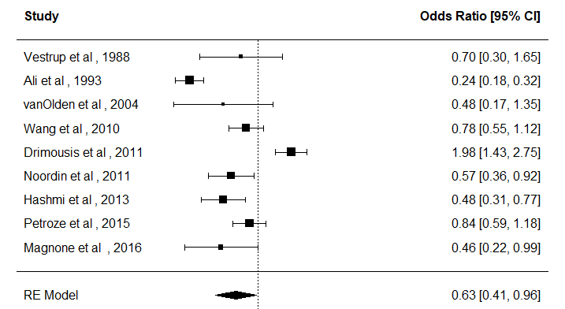
ATLS® Evidence of impact on patient outcomes
Updated systematic review:
search in January 2024;
screened 8,619 records; and
included 9 observational studies.

Slide 13
Aim To compare the effects of ATLS® training with standard care on outcomes in adult trauma patients

Slide 14
Design Key aspects and justification
Study design
Batched stepped-wedge cluster randomised trial:
30 hospitals
6 batches
5 sequences
13 months in trial
Justification
Will be conducted in India because:
Ongoing collaborations > 10 years
ATLS training not yet standard

Slide 15
Design Cluster randomised designs
A. Parallel design
1 | Intervention
2
3 | Control
4
 | 1 | 2 | 3 | 4 | 5 | 6 | 7 | 8 | 9 | 10
B. Parallel design with before and after
1 | Control |  |  |  |  | Intervention
2
3
4
 | 1 | 2 | 3 | 4 | 5 | 6 | 7 | 8 | 9 | 10
C. Stepped-wedge design
1 | Control |  | Intervention
2
3
4
 | 1 | 2 | 3 | 4 | 5 | 6 | 7 | 8 | 9 | 10
D. Batched stepped-wedge design
1 | Control |  | Intervention
2
3
4
 | 1 | 2 | 3 | 4 | 5 | 6 | 7 | 8 | 9 | 10

Slide 16
Design ATLS vs standard care batched stepped-wedge design

Slide 17
Eligibility criteria
Hospital
Secondary or tertiary hospitals in India that admit or refer/transfer for admission at least 400 patients with trauma per year
Cluster
One or more units of physicians providing initial trauma care in the participating hospitals
Patient
Adult trauma patients presenting to the emergency department of participating hospitals and who are admitted

Slide 18
Intervention and control ATLS and standard care
Intervention
2.5 day ATLS training course
Accredited ATLS training facility in India
1-2 units per hospital
Control
Standard care varies across hospitals in India
Trauma patients are initially managed by 1st or 2nd year resident
No formal trauma life support training

Slide 19
Outcomes Primary outcome
30-day in-hospital mortality
Collected through medical records for patients admitted or discharged home
Collected through telephonic follow-up for patients transferred to another hospital

Slide 20
Outcomes Secondary outcomes
All cause and in-hospital mortality at 24 hours, 30 days and 90 days
Quality of life, measured using EQ5D5L at 30 days and 90 days
Disability, measured using WHODAS 2.0 at 30 days and 90 days
Return to work, measured at 30 days and 90 days
Length of stay, in the ED, ICU and hospital

Slide 21
Safety events Collected to capture complications
Indicative of pulmonary, renal, septic or bleeding complications:
Prolonged mechanical ventilation (> 7 days)
Initiation of renal replacement therapy
Prolonged (> 2 days) or renewed (restart after at least 2 days without) use of vasopressors

Slide 22
Sample size Effect size, cluster and patients
Detect a reduction in 30-day in-hospital mortality from 20 to 15% with 90% power
30 clusters
4320 patients
Requires at 12 patients per cluster and period (month)

Slide 23
Statistical methods Principles and considerations
Intention to treat
Mixed effects binomial regression
Logit link function for odds ratios
Identify link function for risk differences
Account for clustering across hospitals, secular trend, batch

Slide 24
Trial organisation Organisations, groups and committees
Joint Steering and Data Monitoring Committee
External independent members, trial oversight and monitoring
Meets yearly
Trial Team
Internal members only, runs the day-to-day
Meets weekly
Trial Management Group
Internal members only, make recommendations and implement decisions
Meets monthly

Slide 25





Trial organisation Main applicants
Lisa Strömmer
Ass. Professor
Martin Gerdin Wärnberg
Ass. Professor
Li Felländer-Tsai
Professor
Karla Hemming
Professor
Vivekanand Jha
Executive Director,
Professor

Slide 26
Current status Ongoing work and plan forward
Funding
Swedish Research Council
Laerdal Foundation
Ethics
Applying for ethical approvals in 1st batch
Expect to start in October 2024
Expect to continue until December 2028, pending more funding

Slide 27
Significance Should we stop training!?

Slide 28
Effects of ATLS® Training on Adult Trauma Patient Outcomes
Protocol for a Cluster Randomised Trial
Martin Gerdin Wärnberg, PI, Karolinska Institutet

Slide 29


